Slide 1
Graph Neural Networks For Social Recommendation

Slide 2
01
Graph Neural Networks (GNN)
02
GraphRec
03
Model
04
Experiment

Slide 3
1
Graph Neural Networks (GNN)

Slide 4
Graph Neural Networks (GNN)
GNN can naturally integrate node information and topological structure.
GNN provide great potential to advance social recommendation since data in social recommender systems can be represented as user-user social graph and user-item graph
Learning latent factors of users and items is the key.

Slide 5
Graph Neural Networks (GNN) Challenges
How to capture interactions and opinions between users and items jointly?
How to distinguish social relations with heterogeneous strengths
How to inherently combine these two graphs
(user-user social graph and user-item graph)
It is important to aggregate information from both graphs to learn better user representations.

Slide 6
2
GraphRec

Slide 7
GraphRec
Provide a principled approach to jointly capture interactions and opinions in the user-item graph
Introduce a method to consider heterogeneous strengths of social relations mathematically
Demonstrate the effectiveness of the proposed framework on various real-world datasets.

Slide 8
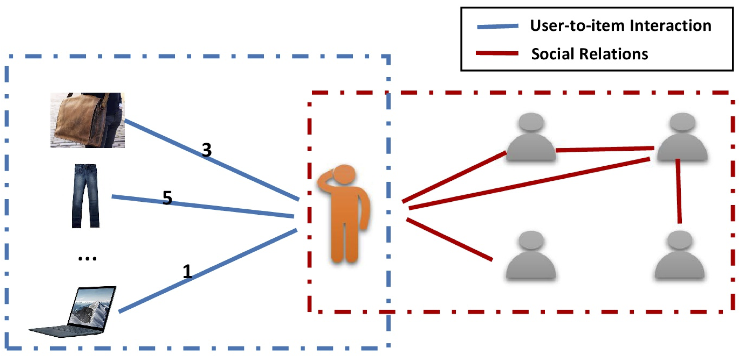
GraphRec
user-user social graph (right part)：denoting relationships between users
user-item graph (left part)：denoting interactions between users and items
the number on the edges of the user-item graph denotes the opinions
(or rating score) of users on the items

Slide 9
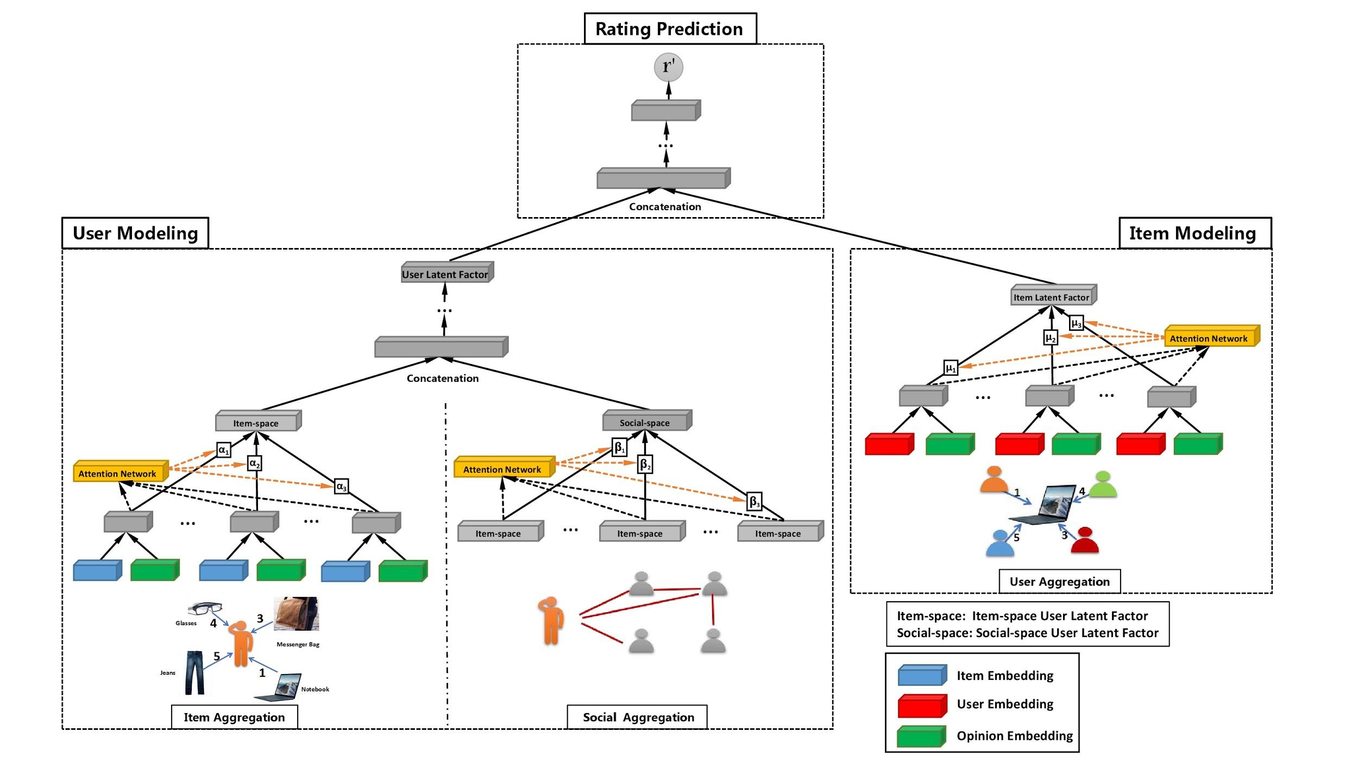
GraphRec
3
Rating Prediction
1
User Modeling
2
Item Modeling
User Latent Factor
Item Latent Factor
User Aggregation
User Aggregation
Item Aggregation
Social Aggregation

Slide 10
3
Model

Slide 11
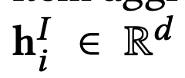
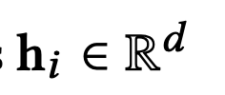

Model - User Modeling
User Modeling
User Latent Factor
Item Space
Social Space
Item Aggregation
Social Aggregation
Item Space
=
+
User Latent Factor
Social Space

Slide 12


User Modeling - Item Aggregation
Item Space
Item Space
σ：non-linear activation function (ReLU)
Aggreitems：items aggregation function
Embedding
Multi-Layer Perceptron (MLP)

Slide 13
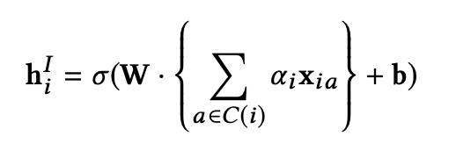
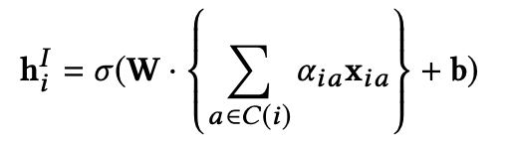
User Modeling - Item Aggregation
Item Space
This may not be optimal, due to the interactions on users may vary dramatically.
We should allow interactions to contribute differently to a user’s latent factor by assigning each interaction a weight.
Assigning an individualized weight for each (va , ui ) pair

Slide 14

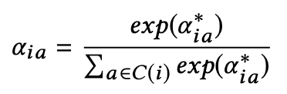
User Modeling - Item Aggregation
Item Space
Attention Network
Two-layer neural network
which we call as the attention network.
Normalizing using Softmax function

Slide 15
Why Embedding
Neural network embeddings have 3 primary purposes:
Finding nearest neighbors in the embedding space. These can be used to make recommendations based on user interests or cluster categories.
As input to a machine learning model for a supervised task.
For visualization of concepts and relations between categories.
The one-hot encoding technique has two main drawbacks:
The dimensionality of the transformed vector becomes unmanageable.
The mapping is completely uninformed: “similar” categories are not placed closer to each other in embedding space.
https://towardsdatascience.com/neural-network-embeddings-explained-4d028e6f0526

Slide 16
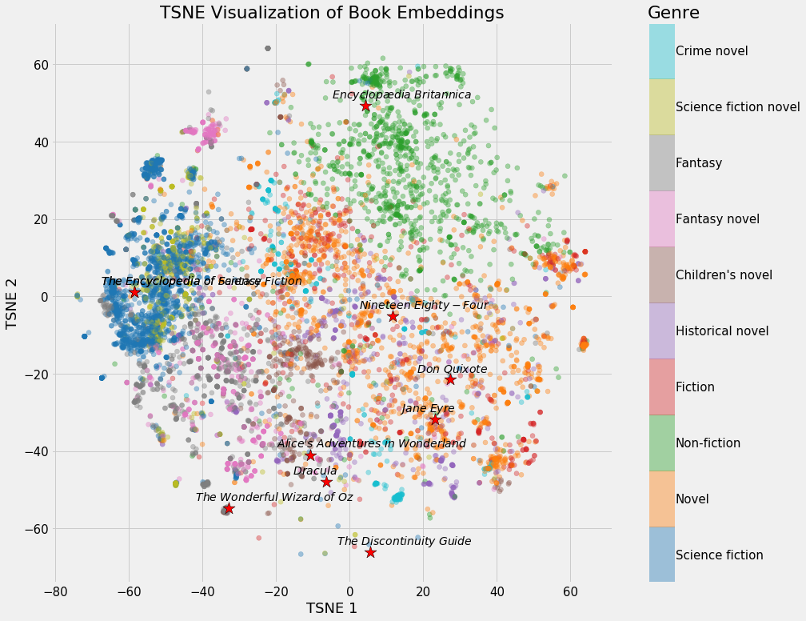
Why Embedding
https://towardsdatascience.com/neural-network-embeddings-explained-4d028e6f0526

Slide 17
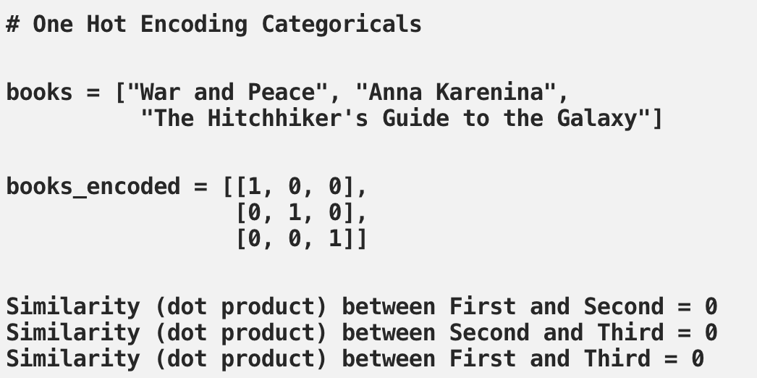
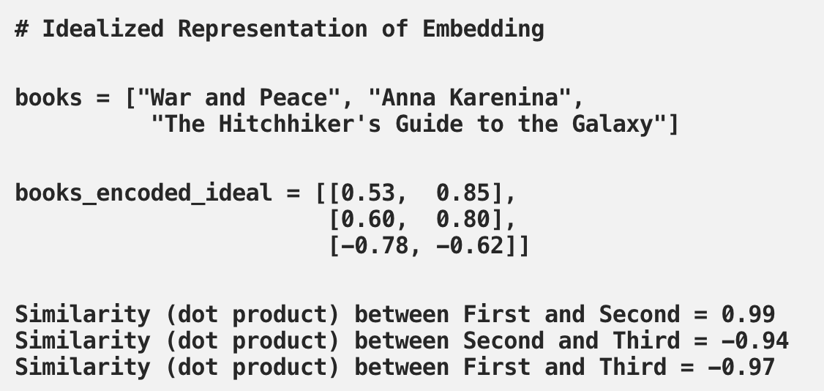
Why Embedding
One Hot Encoding
Embedding
https://towardsdatascience.com/neural-network-embeddings-explained-4d028e6f0526

Slide 18
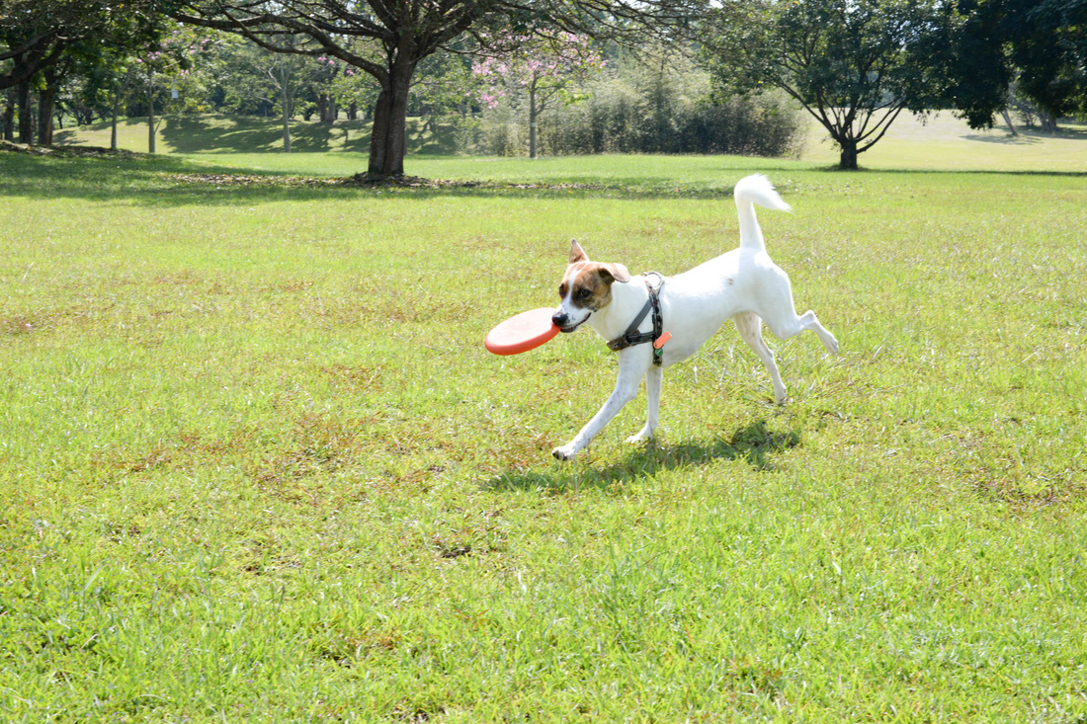
What is Attention？
In psychology, attention is the cognitive process of selectively concentrating on one or a few things while ignoring others.
A neural network is considered to be an effort to mimic human brain actions in a simplified manner. Attention Mechanism is also an attempt to implement the same action of selectively concentrating on a few relevant things, while ignoring others in deep neural networks.

Slide 19
Attention
https://towardsdatascience.com/attn-illustrated-attention-5ec4ad276ee3#0458

Slide 20
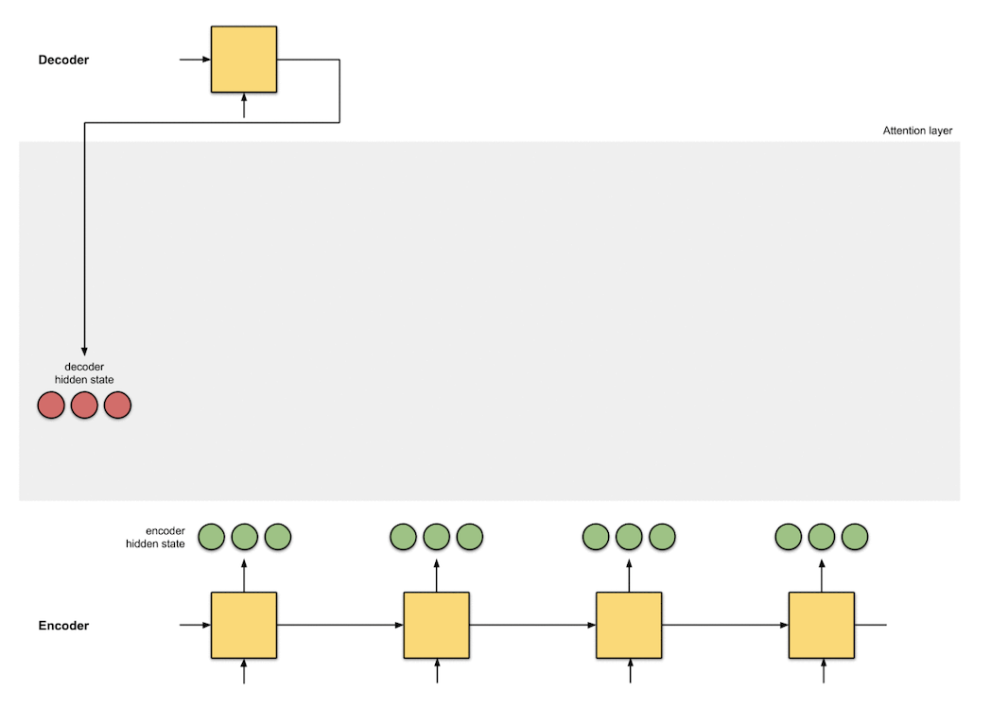
Attention
[10, 5, 10]
[0, 1, 1] [5, 0, 1] [1, 1, 0] [0, 5, 1]
https://towardsdatascience.com/attn-illustrated-attention-5ec4ad276ee3#0458

Slide 21
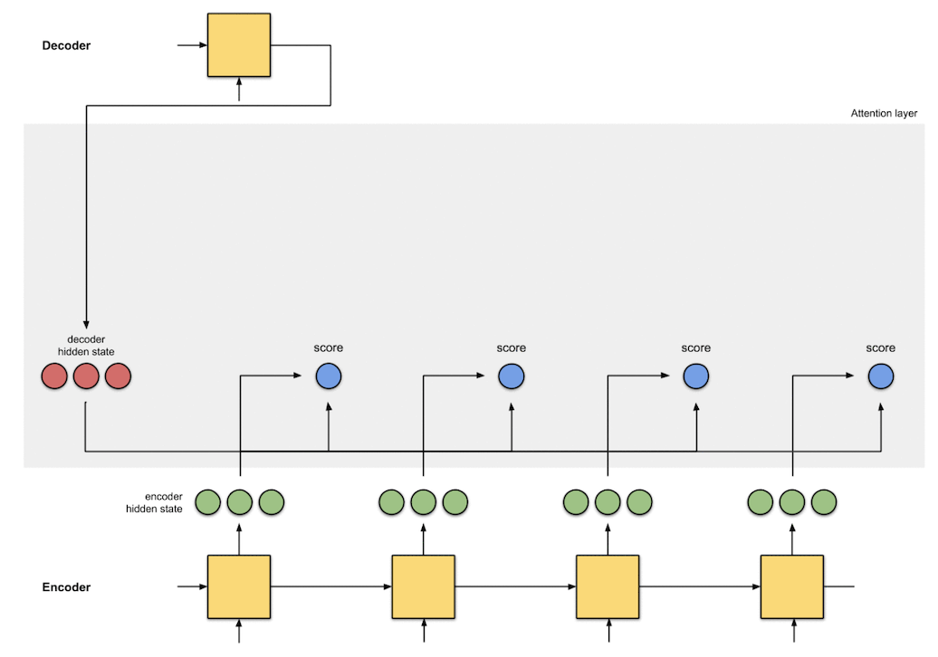
Attention
10x0 + 5x1 + 10x1 = 15
15 60 15 35
[10, 5, 10]
[0, 1, 1] [5, 0, 1] [1, 1, 0] [0, 5, 1]
https://towardsdatascience.com/attn-illustrated-attention-5ec4ad276ee3#0458

Slide 22
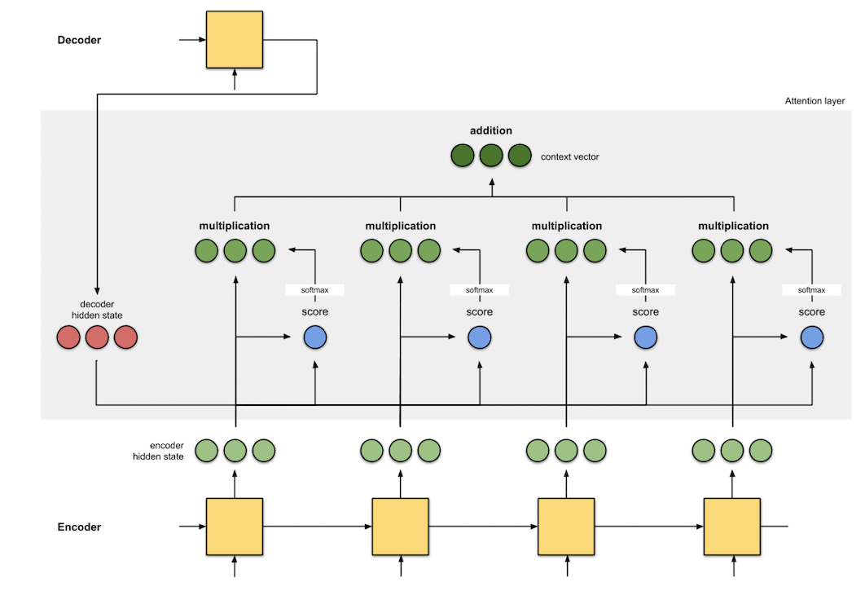
Attention
[5, 0, 1]
[0, 0, 0] [5, 0, 1] [0, 0, 0] [0, 0, 0]
0 1 0 0
[10, 5, 10]
15 60 15 35
[0, 1, 1] [5, 0, 1] [1, 1, 0] [0, 5, 1]
https://towardsdatascience.com/attn-illustrated-attention-5ec4ad276ee3#0458

Slide 23

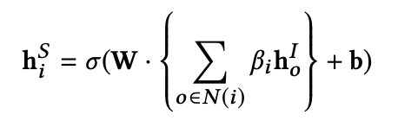
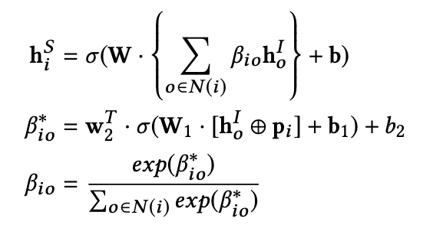
User Modeling - Social Aggregation
Social Space

Slide 24
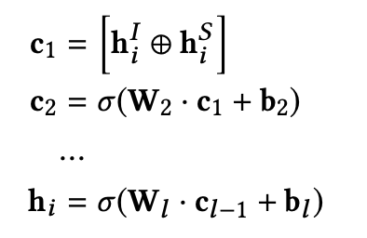
User Latent Factor
User Latent Factor
Item Space
Social Space

Slide 25


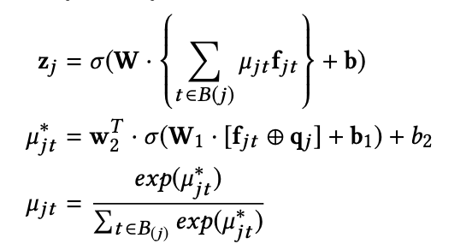
2. Item Modeling
Embedding
Item Latent Factor
Multi-Layer Perceptron (MLP)
User Aggregation

Slide 26
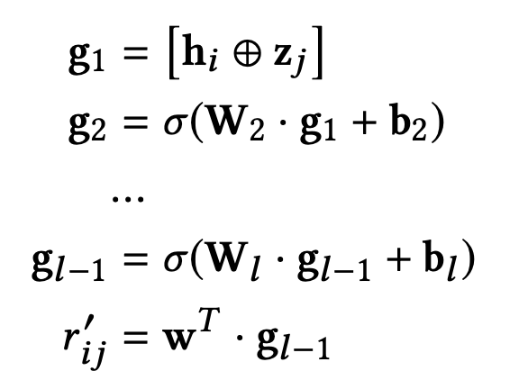
3. Rating Prediction
User Latent Factor
Item Latent Factor

Slide 27
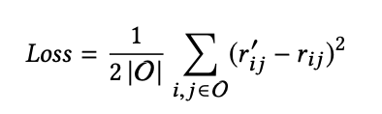
Model Training
Optimizer：RMSprop
We do not use one-hot vectors, since the raw features are very large and highly sparse.
By embedding high-dimensional sparse features into a low-dimensional latent space, the model can be easy to train.
To avoid overfitting, the dropout strategy has been applied to our model.
The idea of dropout is to randomly drop some neurons during the training process.

Slide 28
4
Experiment

Slide 29
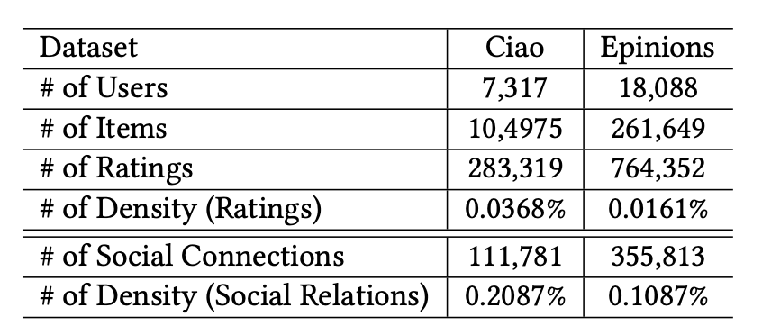
Experiment
Data
Ciao (http://www.ciao.co.uk)
Epinions (www.epinions.com)
Evaluate
MAE
RMSE
Parameter Settings
Training : 80% / Validation : 10% / Testing : 10%
Training : 60% / Validation : 20% / Testing : 20%

Slide 30
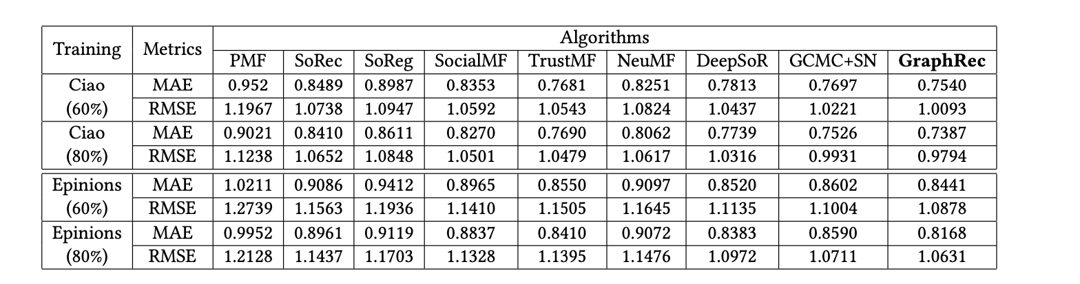
Experiment
Rating information
Rating and Social network information
Rating information（based on Neural network）
Rating and Social network information（based on Neural network）
Rating and Social network information
（consider both interactions and opinions in the user-item graph）

Slide 31
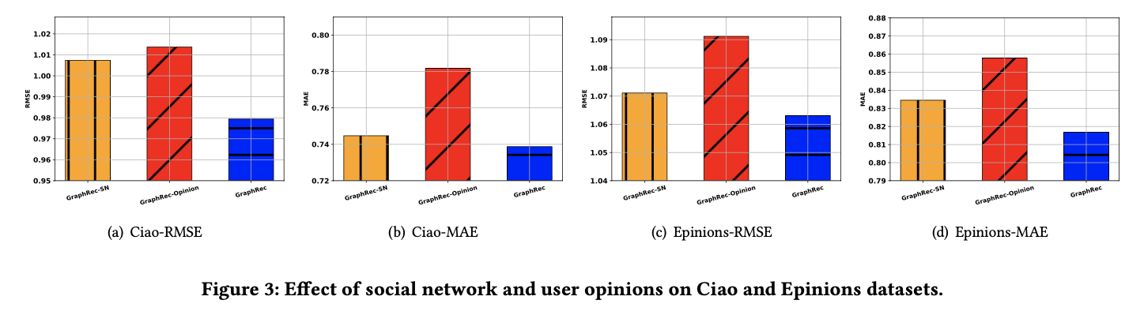
Experiment
Rating information
Social network information
Rating and Social network information

Slide 32
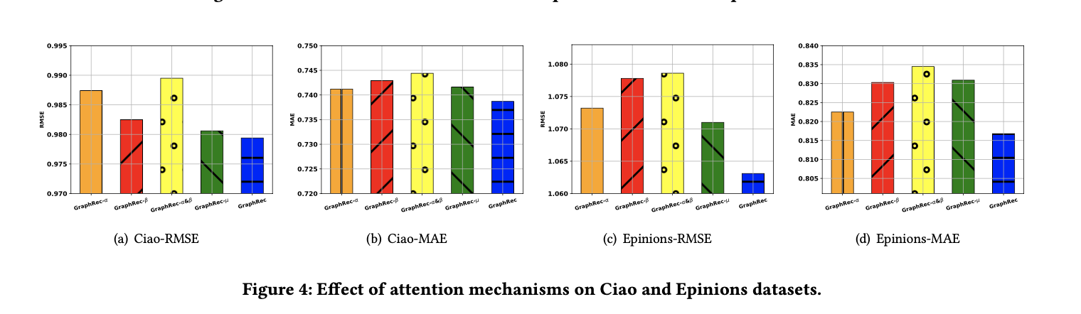
Experiment
Social attention + User attention
Item attention + User attention
User attention
Social attention + Item attention
Social attention + User attention + Item attention
User attention
Item attention
Social attention

Slide 33
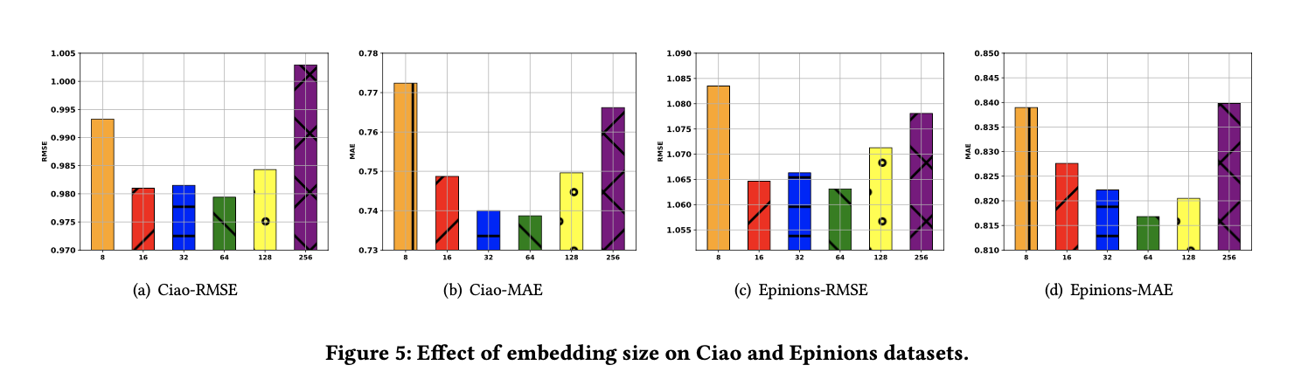
Experiment
Embedding Size
8, 16, 32, 64, 128, 256

Slide 34
THANKS!

